Slide 1
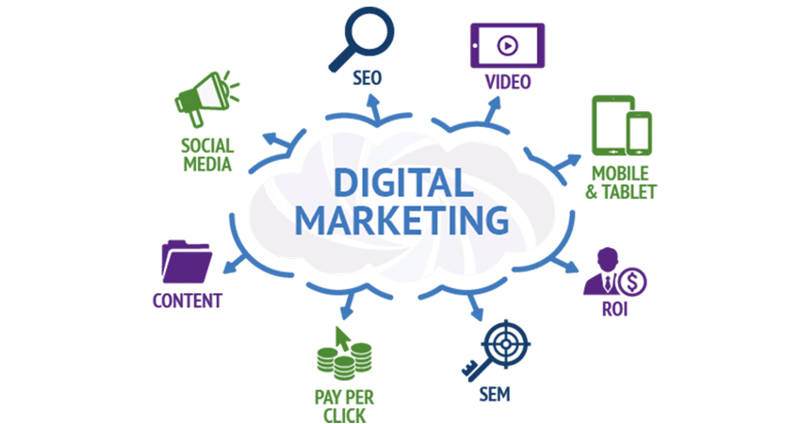
Project 3: Run a Facebook Campaign (Part 1)
Laavanya Ganesh
THE ONLY FASHION THAT NEVER DIES

Slide 2
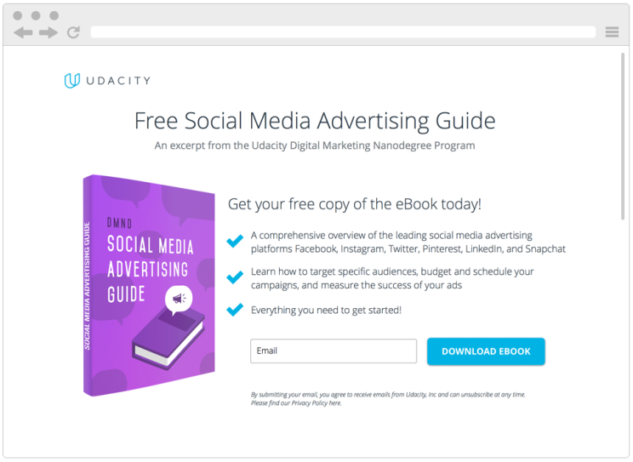
Digital Marketing Nanodegree Program
You are tasked with attracting future fellow students for this Digital Marketing Nanodegree Program. More specifically, your objective is to collect email addresses of potential students, who could be interested in taking this course. In order to do this, we have created a landing page, where prospective students can download a free eBook if they provide us with their email address. The eBook – a Social Media Advertising Guide – is a short excerpt from the Digital Marketing Nanodegree Program, content that you will see in the Social Advertising course. For the purpose of the projects, assume costs of $0 for the eBook and a conversion value (revenue) of $15 per collected email address.

Slide 3
CAMPAIGN APPROACH
The project challenge I have selected is the DMND social media advertising eBook that includes content from the Digital Marketing Nanodegree program at Udacity. Using my target person from the first project, I will be targeting people in their 20-40s, and who also happen to live within USA. My total budget is $100 for this ad campaign. Based on audience interest and behavior I have targeted college graduates and professionals who are interested in their career in digital marketing or are passionate to start their own business. Digital Marketing, Social media marketing, online advertising, entrepreneurship, small businesses, digital nomad, travel, reading books, swimming are some of the interests I have given. My campaign is scheduled to run from Feb 11, 2019 to Feb 15, 2019

Slide 4
DMND Program
MARKETING OBJECTIVE: To convert a minimum of 150 people who viewed the ad during February 11, 2019 to February 15,2019 by gauging the people who landed on the website and downloaded the eBook
PRIMARY KPI: Number of people downloading the free eBook during the ad campaign.

Slide 5
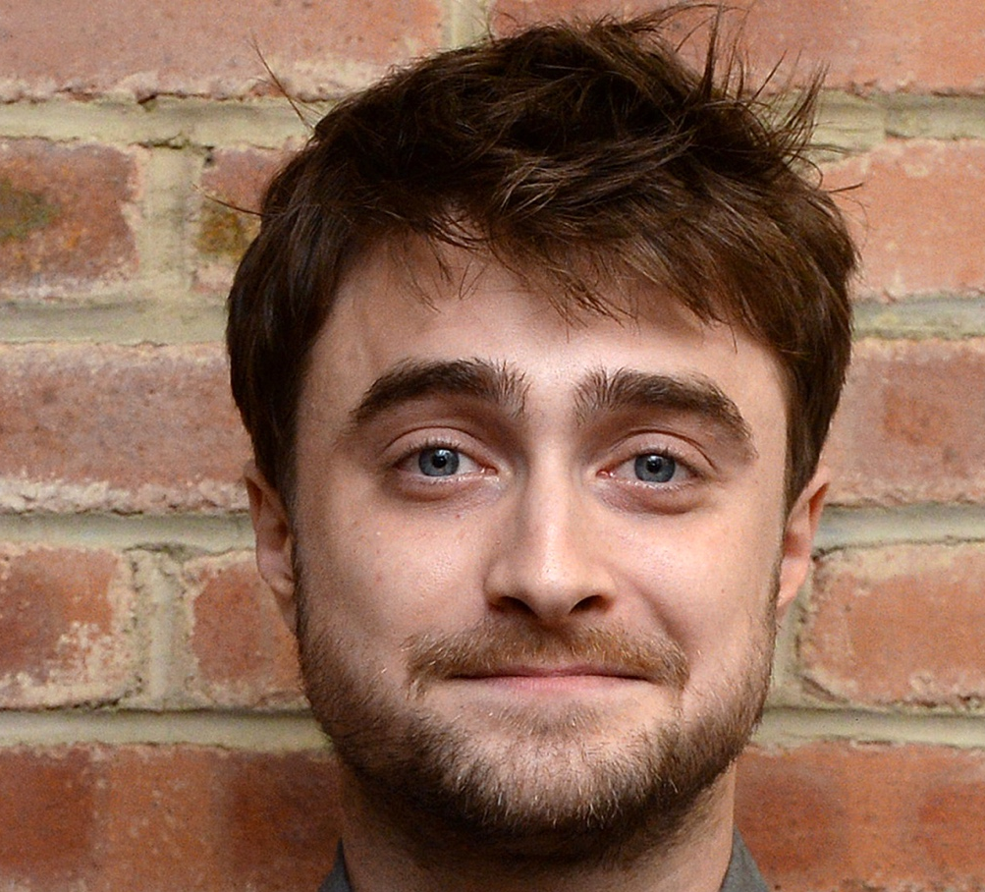
Target Persona
Background
Age: 26 years old
Education: Bachelor’s Degree
Location: California, USA
Job Title: Analyst
Email: Daniel2093@gmail.com
Annual Income: 500000 USD
Needs
Better Work/Life Balance
Growth in a Big Company
Love what I do
Become more technical
Balance between career expectations and family
Being my own boss
Educational content that provides: Quality and environmental friendliness
Target Persona
Daniel Krum
Free Time Activities
Watching movies and TV with friends
Sailing
Reading marketing/digital marketing articles
Biking Traveling
Cooking and baking
Reading, Writing
Spending time outside - swimming, kayaking, snow shoeing
Enjoy live music and travel
Hang out with kids and play basketball
Goals
To be a great marketer
Build something impactful
Want to be the owner of my life
Growth in current role
Would like to be an entrepreneur managing digital marketing for businesses, and have a successful drop shipping business.
Want to be working remotely as a Social Media Marketer/Manager or want to be running my own Affiliate Marketing brand/business
Professionally, want to be working remotely as a Social Media Marketer/Manager or want to be running my own Affiliate Marketing brand/business
To have a remote job as a digital marketer by March 2019. To travel to all 50 states by December 2019
More passion focused
Barriers
Travel time to work
From a small town, lack of marketing opportunity here outside of being a freelancer
Lack of time
Obtaining a degree that doesn't help get the jobs
Work Over 40 Hours Weekly
Price of Nanodegree programs
Mental barriers, hesitation
Lacking skills to do the job

Slide 6
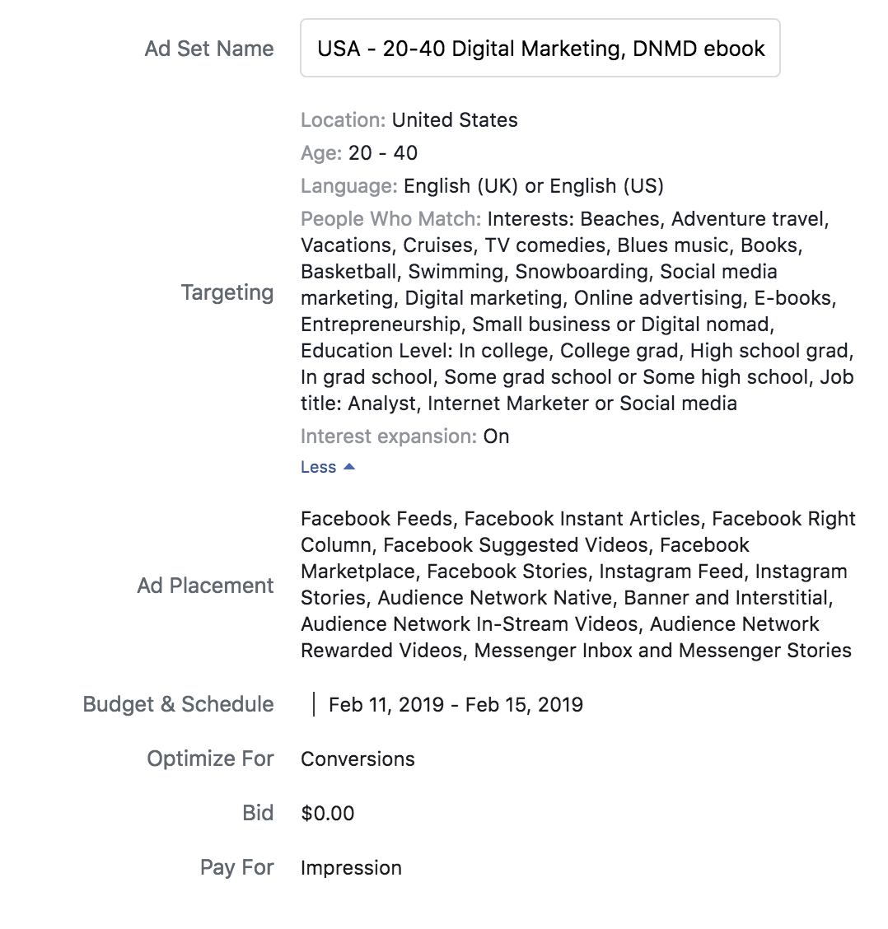
AD SET SUMMARY

Slide 7
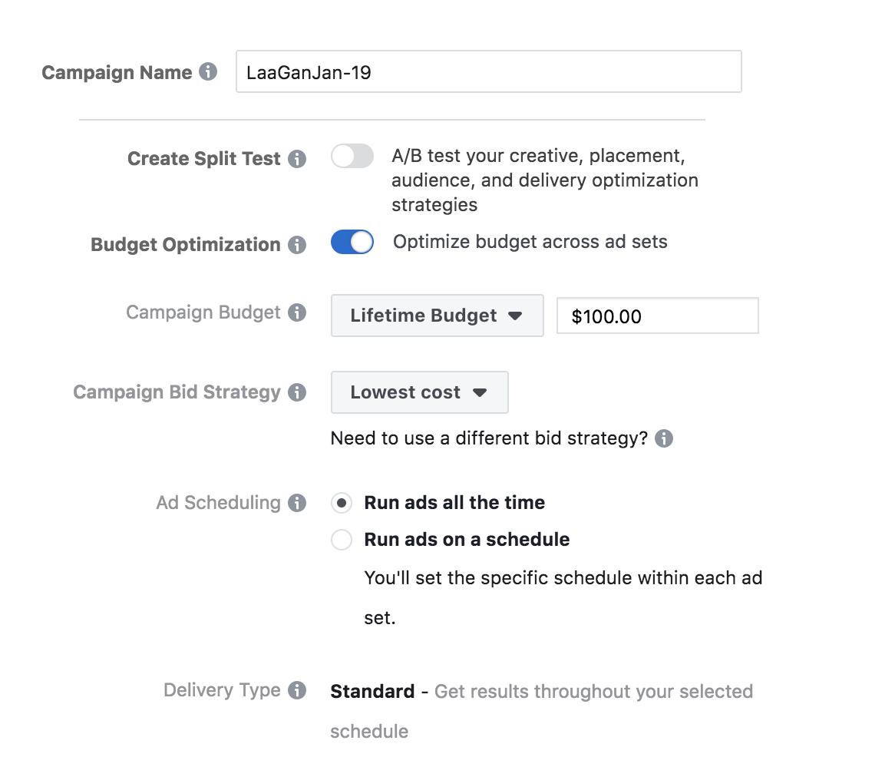
CAMPAIGN
SUMMARY

Slide 8
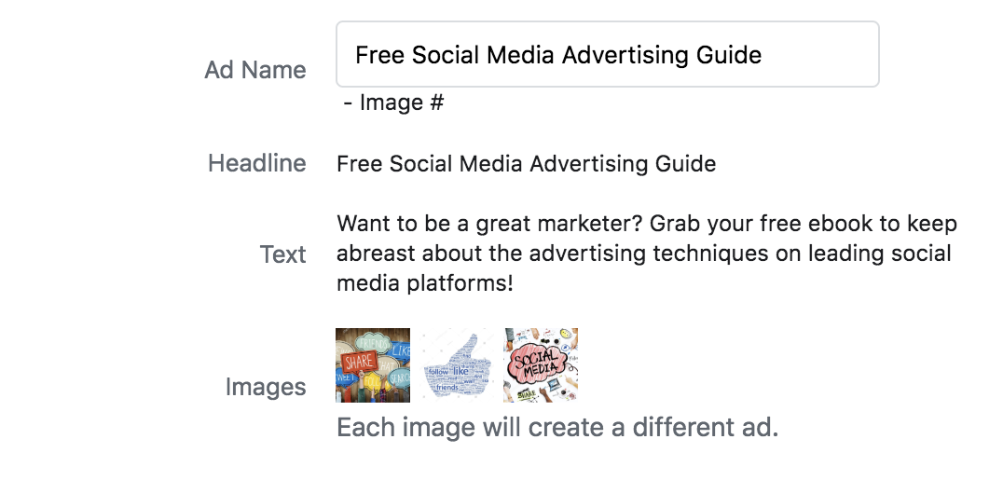
AD SUMMARY

Slide 9
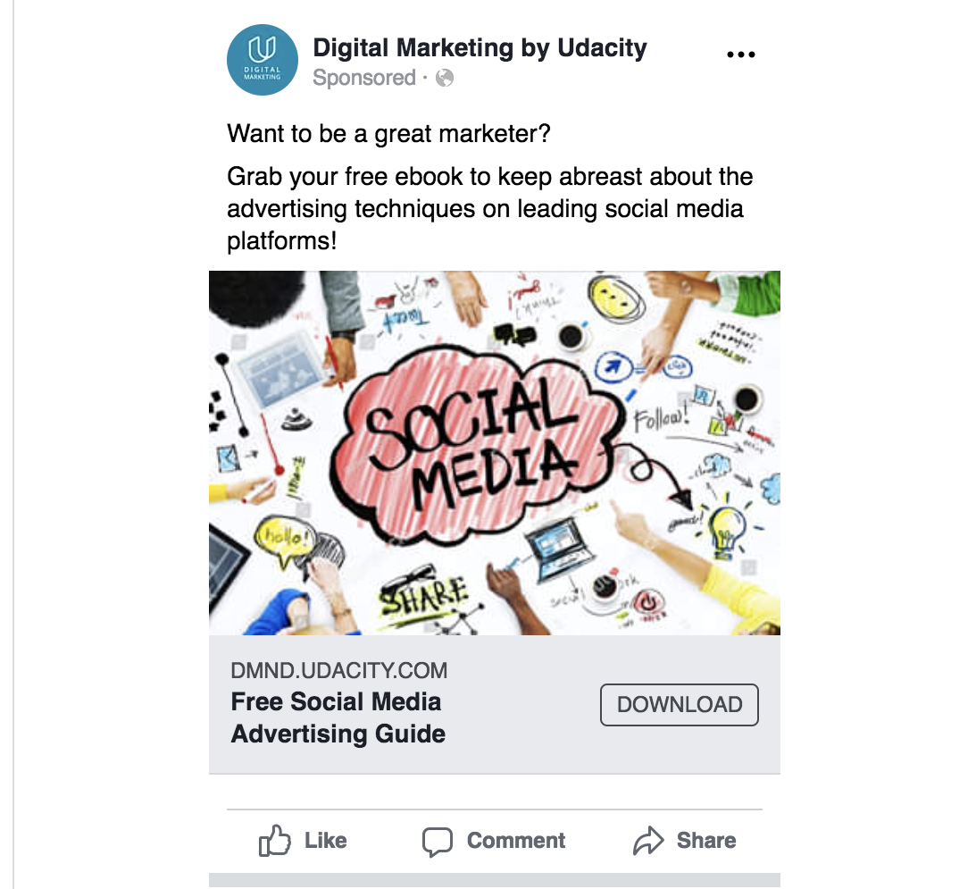
AD IMAGE-1

Slide 10
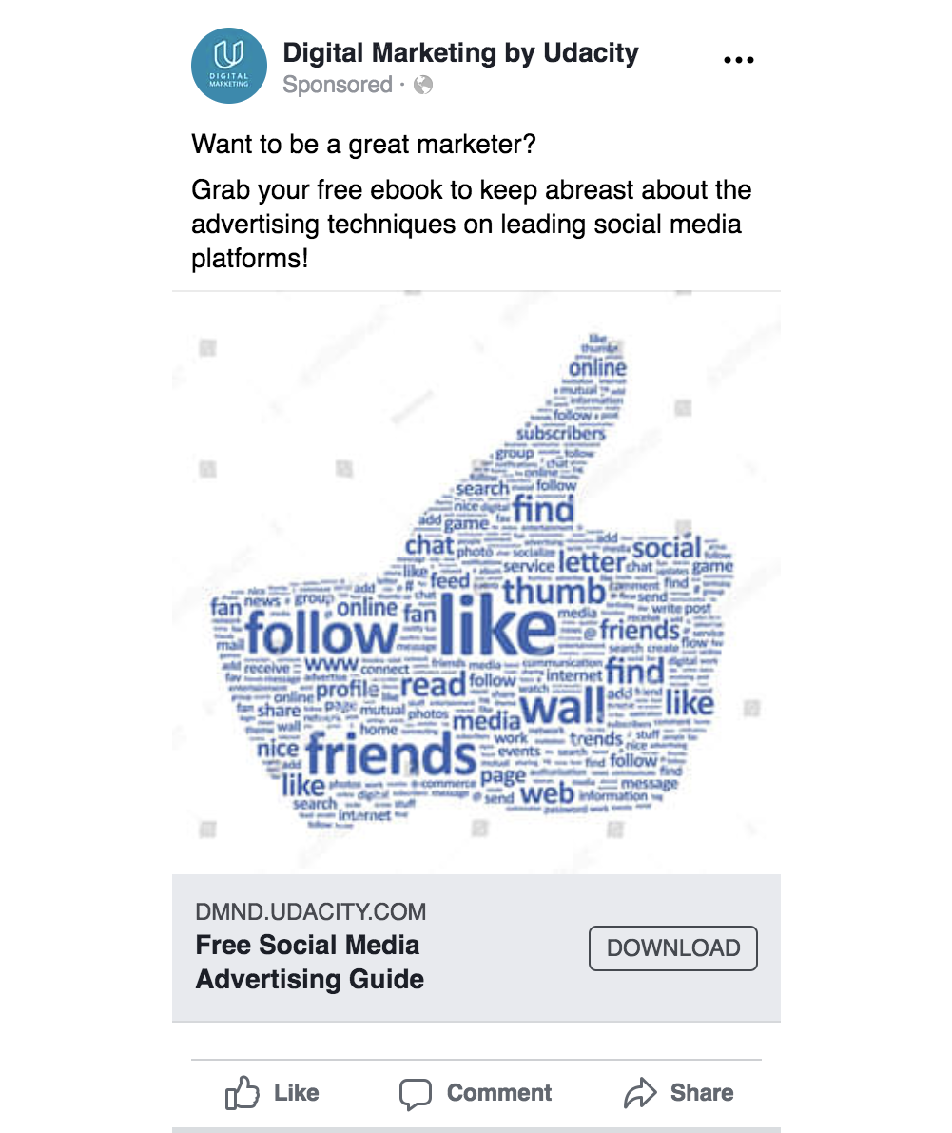
AD IMAGE-2

Slide 11
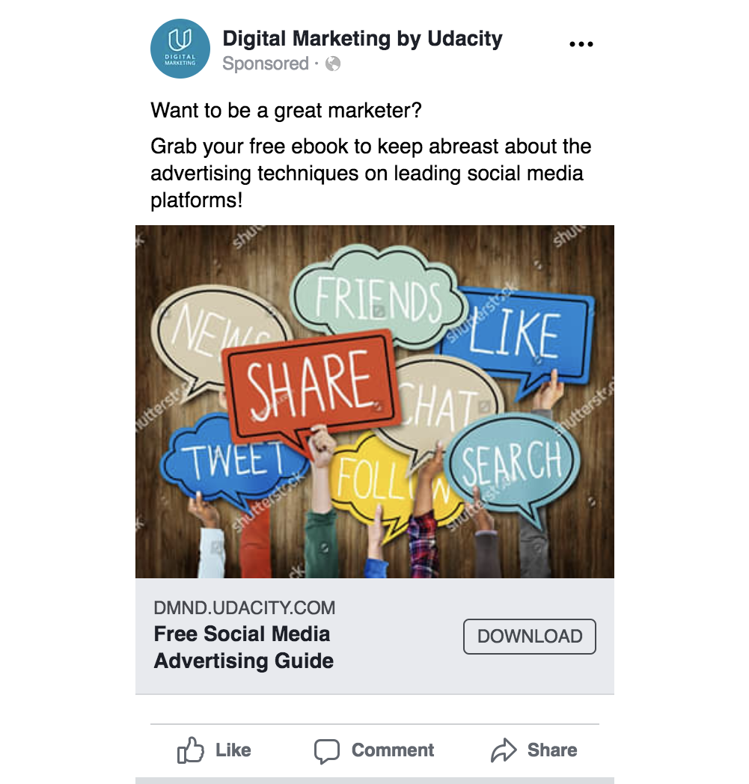
AD IMAGE-3

